Slide 1

FUNDAMENTALS OF MACHINE LEARNING
REGIONAL RAINFALL PREDICTION
Using Regression Techniques for Tamil Nadu
PROJECT PRESENTATION • REFERENCE PAPERS • FORECAST DATA
Tamil Nadu • Consolidated project and dataset guide
Page 1

Slide 2

FML PROJECT | REGIONAL RAINFALL PREDICTION
Presented by: P. Girishkumar
Department: Computer science and engineering
College: Sri chandhrashekarendhra Saraswathi Vishwamaha vidhyalaya
Academic Year: 2026-27 (2nd year )
A clear, student-friendly guide combining the presentation, research-paper references, and the supplied 24-hour forecast CSV. Headings and key prompts are highlighted for easier reading.
Tamil Nadu • Consolidated project and dataset guide
Page 2

Slide 3

FML PROJECT | REGIONAL RAINFALL PREDICTION
1. PROJECT OVERVIEW
What is rainfall prediction? Rainfall prediction uses past and available weather observations to estimate how much rain may occur during a future period. In this project, the target is rainfall measured in millimetres (mm).
Why is it useful in Tamil Nadu? Rainfall patterns differ across coastal, inland, agricultural, and hilly districts. Historical weather data can help study these differences and support local planning for agriculture, reservoirs, groundwater, drainage, and water resources.
KEY PROMPT: Can historical weather data help a regression model estimate rainfall for a selected Tamil Nadu region?
Project scope
This is an educational machine-learning prototype for regional or district-level rainfall estimation. It is not an official
weather-warningsystem,andmodelestimatesshould notreplace officialmeteorological advisories.
2. PROBLEM STATEMENT AND OBJECTIVES
Rainfall can vary significantly across Tamil Nadu and between seasons. General seasonal expectations may not be sufficient for local planning. This project explores whether historical rainfall and weather variables can be used to estimate rainfall for a selected location and period.
• Collect and prepare historical rainfall and weather data for a defined district or station.
• Identify useful input features such as date/month, temperature, humidity, cloud cover, and previous rainfall when available.
• Train a regression model to predict rainfall amount in millimetres.
• Compare predicted rainfall with actual observations using suitable error metrics.
• Explain the model’s usefulness, assumptions, and limitations.
EXPECTED OUTCOME: A simple model that accepts weather-related inputs and returns an estimated rainfall amount in mm, along with evaluation measures describing prediction quality.
Tamil Nadu • Consolidated project and dataset guide
Page 3

Slide 4
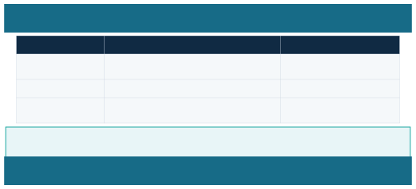

FML PROJECT | REGIONAL RAINFALL PREDICTION
3. REGIONAL RELEVANCE: TAMIL NADU
REGION / CONTEXT
WHY STUDY IT?
POSSIBLE USE
Coastal districts
Rainfall and heavy-rain events can affect towns, drainage, and transport.
Local planning and awareness
Agricultural districts
Rainfall influences sowing decisions and crop-water planning.
Farm and water planning
Hilly / western areas
Elevation and local weather can produce different rainfall patterns.
Regional comparison
IMPORTANT: Begin with one district or a consistent regional dataset. A model trained for one location may not generalize equally well to every district in Tamil Nadu.
4. DATASET AND INPUT FEATURES
Each row in the modelling dataset should represent a consistent time period—such as a day, week, or month—for a chosen location. The target column is the rainfall recorded during that period.
FEATURE
MEANING
EXAMPLE / UNIT
Date / month Temperature Humidity Previous rainfall Rainfall target
Time of observation; helps represent seasonal patterns. Air temperature.
Moisture in the air.
Rain measured in earlier periods.
Amount the model must estimate.
2025-11 / November Degrees Celsius (°C) Percent (%) Millimetres (mm)
mm per day / month
Data preparation checklist
• Check missing values and invalid records.
• Keep units consistent and sort observations by date.
• Record the exact location, time period, units, and dataset source.
• Avoid future information in the inputs; this prevents data leakage.
• Prefer reliable historical records, for example from the India Meteorological Department (IMD) or other clearly documented sources.
Tamil Nadu • Consolidated project and dataset guide
Page 4

Slide 5

FML PROJECT | REGIONAL RAINFALL PREDICTION
5. PROPOSED METHODOLOGY
1. Collect data
Gather historical rainfall and weather observations for the selected Tamil Nadu district or station.
2. Clean data
Handle missing values, remove invalid records, and standardize units.
3. Select features
Choose relevant time, seasonal, and weather variables that are actually available.
4. Split chronologically
Use earlier observations for training and later observations for testing.
5. Train model
Fit Linear Regression first; optionally compare with Random Forest Regression.
6. Evaluate and explain
Compare predictions with measured rainfall using MAE and RMSE; graph actual versus predicted values.
WHY CHRONOLOGICAL SPLITTING? Rainfall is time-series data. Testing on later dates better represents the real task of predicting future observations than randomly mixing past and future records.
6. REGRESSION ALGORITHMS
Regression predicts a numerical value. Here, the numerical target is rainfall in millimetres.
Linear Regression — baseline model
A simple baseline estimates rainfall as a weighted combination of input features:
Predicted rainfall = b■ + b■x■ + b■x■ + … + b■x■
The x values are inputs such as month, temperature, humidity, or previous rainfall. The b values are coefficients learned during training.
Random Forest Regression — comparison model
Random Forest combines predictions from many decision trees and can learn more complex relationships. It may perform better than Linear Regression, but the actual performance must be checked on test data. Start with Linear Regression because it is straightforward to explain, then compare it with Random Forest Regression.
Tamil Nadu • Consolidated project and dataset guide
Page 5

Slide 6
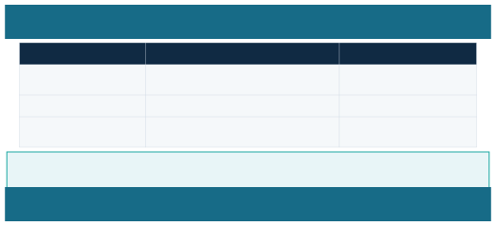
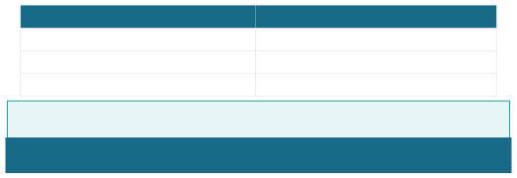
FML PROJECT | REGIONAL RAINFALL PREDICTION
7. TRAINING, TESTING AND EVALUATION
METRIC
WHAT IT MEANS
HOW TO INTERPRET IT
MAE — Mean Absolute Error
Average absolute difference between actual and predicted rainfall.
Lower is better; measured in mm.
RMSE — Root Mean Squared Error
Penalizes larger prediction errors more strongly.
Lower is better; measured in mm.
R² — Coefficient of determination
Indicates how well predictions explain variation in the target.
Closer to 1 can indicate a better fit; use alongside error metrics.
ILLUSTRATIVE EXAMPLE ONLY: If test MAE were 8 mm, predictions would differ from actual rainfall by 8 mm on average in absolute terms. This is not a measured result from this project.
8. EXPECTED OUTPUT AND DEMONSTRATION
A simple dashboard or notebook can let a user select a location and enter available weather features, then display an estimated rainfall amount.
INPUT
OUTPUT
District / weather station
Estimated rainfall: ___ mm
Month or date
Model used: Linear Regression / comparison model
Temperature, humidity, previous rainfall (if available)
Evaluation: MAE / RMSE and actual-versus-predicted graph
SUGGESTED TOOLS: Python for implementation; Pandas and NumPy for data handling; Matplotlib for charts; Scikit-learn for models and metrics; optional Streamlit for an interactive interface.
9. APPLICATIONS, BENEFITS AND LIMITATIONS
Applications and benefits
• Supports agricultural and water-resource planning.
• Helps compare rainfall patterns across time periods and locations.
• Demonstrates a practical use of regression in machine learning.
Limitations
• Rainfall depends on complex atmospheric conditions.
• Poor, incomplete, or inconsistent data can reduce accuracy.
• A model trained in one region may not work equally well elsewhere.
• Historical-data models are not substitutes for official forecasts.
RESPONSIBLE USE: Clearly label model output as an estimate. Refer to official meteorological advisories for safety-critical decisions.
Tamil Nadu • Consolidated project and dataset guide
Page 6

Slide 7
FML PROJECT | REGIONAL RAINFALL PREDICTION
10. RESEARCH PAPER REFERENCES
Paper 1 — Primary reference
Title: “Monthly rainfall hind-cast using machine learning algorithms for Coimbatore, Tamil Nadu”
Authors: V. Geethalakshmi, S. Kokilavani, S. P. Ramanathan, G. A. Dheebakaran, N. K. Sathyamoorthy, and N. Maragatham.
Journal: MAUSAM, Volume 73, Issue 1, pages 19–26 (2022).
DOI: 10.54302/mausam.v73i1.5077
The study uses historical monthly weather parameters from 1976 to 2017 and compares Decision Tree Regression, Gradient Boosting, AdaBoost, and Random Forest Regression. Random Forest Regression performed best among the methods tested in that study setup. Use this as the main reference because it directly concerns monthly rainfall in Coimbatore, Tamil Nadu.
Official paper page: https://mausamjournal.imd.gov.in/index.php/MAUSAM/article/view/5077
Paper 2 — Supporting reference
Title: “Rainfall Forecasting Using Machine Learning Algorithms for Localized Events”
Authors: Ganapathy Pattukandan Ganapathy, Kathiravan Srinivasan, Debajit Datta, Chuan-Yu Chang, Om Purohit, Vladislav Zaalishvili, and Olga Burdzieva.
Journal: Computers, Materials & Continua, Volume 71, Issue 3, pages 6333–6350 (2022).
DOI: 10.32604/cmc.2022.023254
This paper studies localized rainfall forecasting for Vellore, Tamil Nadu. It explores time-series approaches such as ARIMA, exponential smoothing, and LSTM, alongside Linear Regression, Support Vector Regression, and XGBoost Regression. It emphasizes data preparation, feature engineering, chronological data handling, and test-data evaluation.
Full-text paper: https://www.techscience.com/cmc/v71n3/46497
LITERATURE REVIEW — READY TO ADAPT
Previous studies have explored machine-learning methods for regional rainfall estimation in Tamil Nadu. Geethalakshmi et al. (2022) investigated monthly rainfall hind-casting for Coimbatore and compared tree-based ensemble methods with other regression algorithms. Ganapathy et al. (2022) studied localized rainfall forecasting in Vellore using time-series and regression approaches. These studies highlight the importance of historical rainfall records, careful data preparation, and objective model evaluation. This project can build on the studies by implementing Linear Regression as a baseline and comparing it with Random Forest Regression using a chronological test split.
REFERENCE PRACTICE: Do not copy reported scores from research papers as your own results. Train your model on your selected dataset and report your actual evaluation results.
Tamil Nadu • Consolidated project and dataset guide
Page 7

Slide 8


FML PROJECT | REGIONAL RAINFALL PREDICTION
11. SUPPLIED FORECAST CSV — DATA SUMMARY
The supplied file rainvision_24_hour_forecast.csv contains 24 hourly forecast records from 12 October 2026 at 12:00 through 13 October 2026 at 11:00. It includes local time, rain amount, rain chance, temperature, humidity, and cloud cover.
RECORDS
TIME RANGE
COLUMNS
RAINFALL VALUES
24 hourly rows
12 Oct 2026 12:00 – 13 Oct 2026 11:00
6 variables
Rain (mm) is 0 for all 24 rows in this file.
IMPORTANT DATASET NOTE
This CSV is a short, single-day forecast table, not a long historical rainfall dataset. It can be used to demonstrate how forecast variables are organized, but it is not sufficient by itself to train and validate a reliable regional rainfall regression model. For model training, obtain a longer historical dataset with a clearly identified location and observed rainfall values.
Variable guide
• Local time — forecast time of each row.
• Rain (mm) — rainfall amount shown in the supplied forecast table.
• Rain chance (%) — forecast probability/likelihood of rain as represented in the file.
• Temperature (C) — temperature in degrees Celsius.
• Humidity (%) — relative humidity percentage.
• Cloud cover (%) — cloud-cover percentage.
Quick observations from the supplied file
• Rain chance ranges from 0% to 30%.
• Temperature ranges from 25.6°C to 33.4°C.
• Humidity ranges from 49% to 91%.
• Cloud cover ranges from 2% to 94%.
• The rainfall amount column is zero in every row, so this file alone cannot teach a model how to predict a range of observed rainfall amounts.
Tamil Nadu • Consolidated project and dataset guide
Page 8

Slide 9
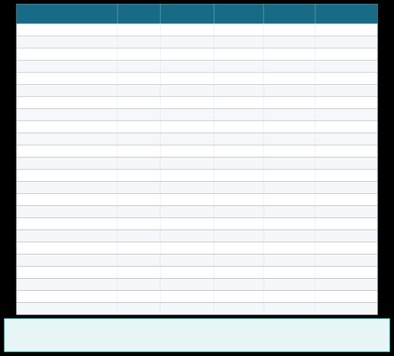
FML PROJECT | REGIONAL RAINFALL PREDICTION
12. HOURLY FORECAST DATA — COMPLETE APPENDIX
The table below reproduces all 24 rows from the supplied CSV so the forecast file is included in the same document. Times are shown as provided; no location metadata was present in the CSV columns.
Local time
Rain (mm)
Rain chance (%)
Temp. (°C)
Humidity (%)
Cloud cover (%)
2026-10-12 12:00 2026-10-12 13:00 2026-10-12 14:00 2026-10-12 15:00 2026-10-12 16:00 2026-10-12 17:00 2026-10-12 18:00 2026-10-12 19:00 2026-10-12 20:00 2026-10-12 21:00 2026-10-12 22:00 2026-10-12 23:00 2026-10-13 00:00 2026-10-13 01:00 2026-10-13 02:00 2026-10-13 03:00 2026-10-13 04:00 2026-10-13 05:00 2026-10-13 06:00 2026-10-13 07:00 2026-10-13 08:00 2026-10-13 09:00 2026-10-13 10:00 2026-10-13 11:00
0 0 0 0 0 0 0 0 0 0 0 0 0 0 0 0 0 0 0 0 0 0 0 0
30 29 27 21 13 6 3 1 0 0 1 2 3 3 4 5 6 6 6 5 4 3 1 2
33.0 33.0 32.7 32.1 31.0 29.7 28.9 28.5 28.3 28.2 27.8 27.3 27.1 26.8 26.5 26.4 26.0 25.6 25.8 27.6 29.6 31.5 32.8 33.4
52 51 51 53 58 66 72 75 77 77 79 82 83 84 86 87 89 91 90 83 73 60 52 49
73 57 58 41 8 2 2 5 12 12 12 11 13 11 18 11 8 38 94 60 58 80 77 60
Note: The CSV values are presented as supplied. The file does not state the forecast location or the data provider, so these details should be added before formal academic submission.
Tamil Nadu • Consolidated project and dataset guide
Page 9

Slide 10
FML PROJECT | REGIONAL RAINFALL PREDICTION
13. CONCLUSION AND FUTURE SCOPE
This project applies regression techniques to estimate rainfall using weather observations for a selected region of Tamil Nadu. It demonstrates a clear FML workflow: data collection, cleaning, feature selection, model training, chronological testing, and evaluation.
Future improvements
• Use more years of reliable, location-specific observed rainfall data.
• Compare Linear Regression, Random Forest Regression, and other suitable models.
• Include seasonal and geographical features when available.
• Build a dashboard with district selection and trend graphs.
• Retrain and validate the model as new observations become available.
• Add the dataset source, date range, actual MAE/RMSE, and actual-versus-predicted graph after model training.
FINAL CHECK BEFORE SUBMISSION
• Fill in presenter, department, college, and academic year.
• State the exact district/station and data source.
• Separate published research findings from your own experiment.
• Use a chronological train/test split.
• Insert only the model scores calculated from your own test data.
• Describe this forecast CSV as a short forecast sample, not as a long historical training dataset.
THANK YOU
Questions?
REFERENCES
[1]V.Geethalakshmi,S. Kokilavani, S. P. Ramanathan, G. A. Dheebakaran, N. K. Sathyamoorthy, and N. Maragatham, “Monthly rainfall
hind-cast using machine learning algorithms for Coimbatore, Tamil Nadu,” MAUSAM, vol. 73, no. 1, pp. 19–26, 2022. DOI: 10.54302/mausam.v73i1.5077.
[2] G. P. Ganapathy, K. Srinivasan, D. Datta, C. Chang, O. Purohit, V. Zaalishvili, and O. Burdzieva, “Rainfall Forecasting Using Machine Learning Algorithms for Localized Events,” Computers, Materials & Continua, vol. 71, no. 3, pp. 6333–6350, 2022. DOI: 10.32604/cmc.2022.023254.
Suggested implementation tools: Python, Pandas, NumPy, Matplotlib, Scikit-learn, and optionally Streamlit. Record the exact versions and data source used in your own implementation.
Tamil Nadu • Consolidated project and dataset guide
Page 10

